Slide 1
Classification of healthy and cancer tissue using opto-magnetic imaging spectroscopy and machine learning techniques
Presented by
Akash Roy
Under supervision of
Dr. Pallab Datta

Slide 2
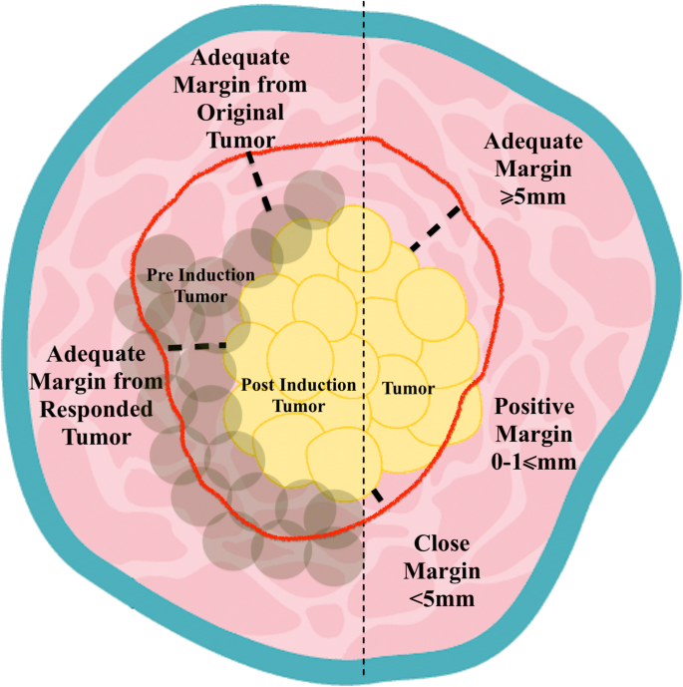
Biomedical motivation
Surgical resection remains the primary treatment for many solid tumors, and failure to pinpoint residual malignant tissue results in positive surgical margins.
The presence of tumor tissue within 1 mm of the specimen surface is generally considered a positive margin, whereas the region which is 5 mm away is considered negative margin.
Presence of tumor between 1 and 5 mm from the cut surface is considered as a close margin.
Margins of surgical resections
of vocal cord

Slide 3
Biomedical motivation
Several proposed techniques for the real-time in-situ assessment of tumor margins are:
Radiofrequency spectroscopy
Raman spectroscopy
Photoacoustics
Optical coherence tomography
Cerenkov luminescence using fluorodeoxyglucose (FDG) tracers
Opto-magnetic imaging spectroscopy (OMIS)
Margins of surgical resections

Slide 4
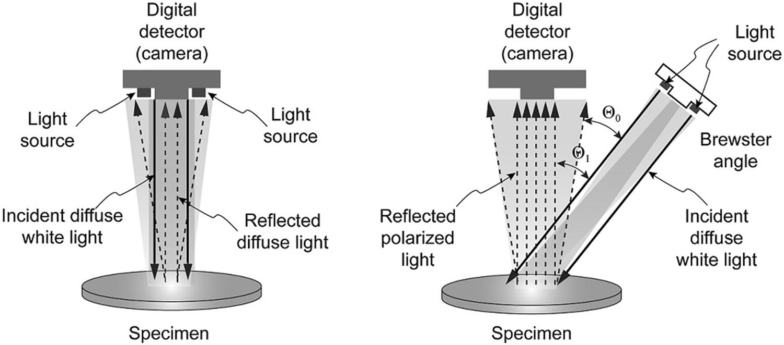
Brief overview of OMIS
It is a non invasive optical method to get magnetic properties of sample.
Cancer cells contain 20% or more free water molecules and the degree
of hydration increases with malignancy.
OMIS can be an alternative technique for diagnosing cancer by
analysing magnetic characteristics of healthy and cancer cells.
The principle of operation of the device used in opto-magnetic imaging spectroscopy

Slide 5
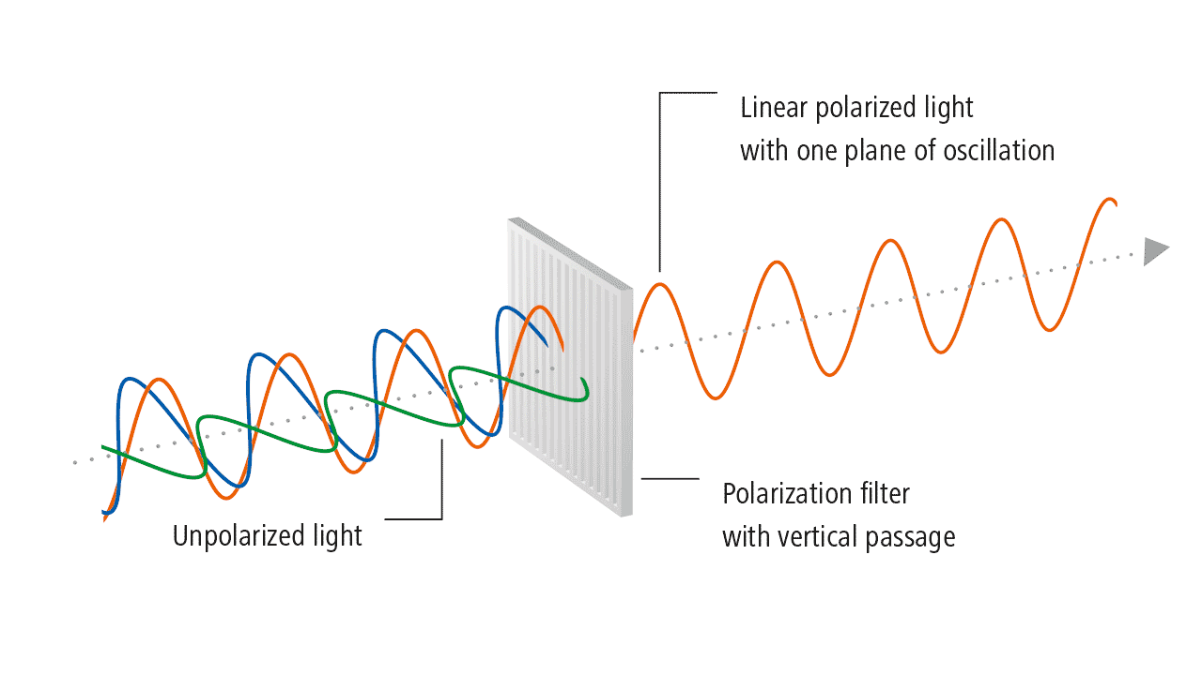
Opto-magnetic imaging spectroscopy

Slide 6
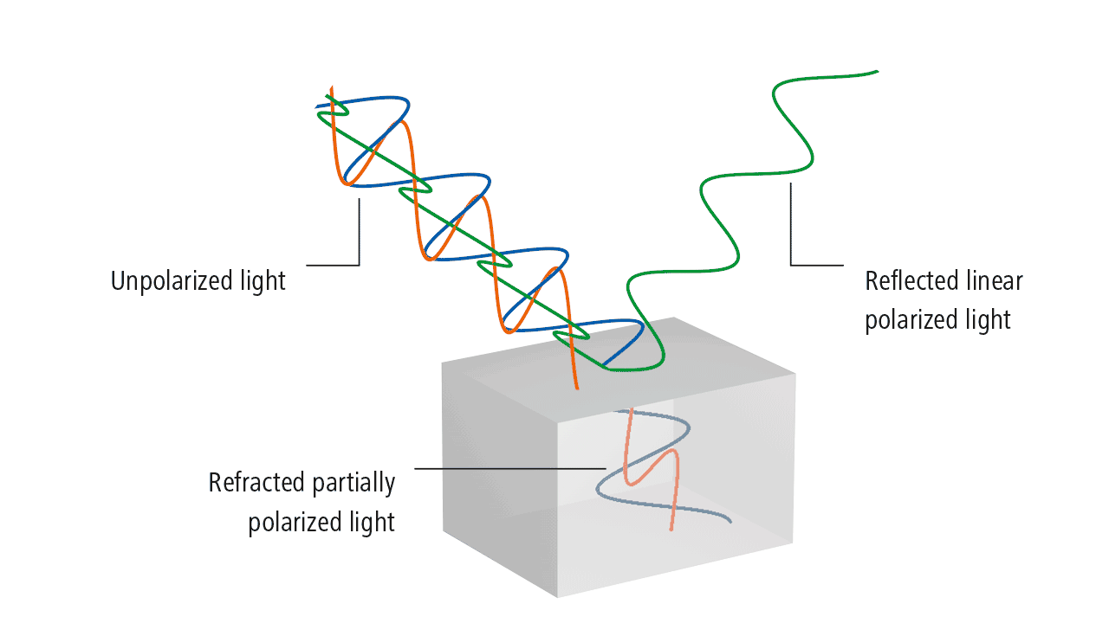
Opto-magnetic imaging spectroscopy

Slide 7
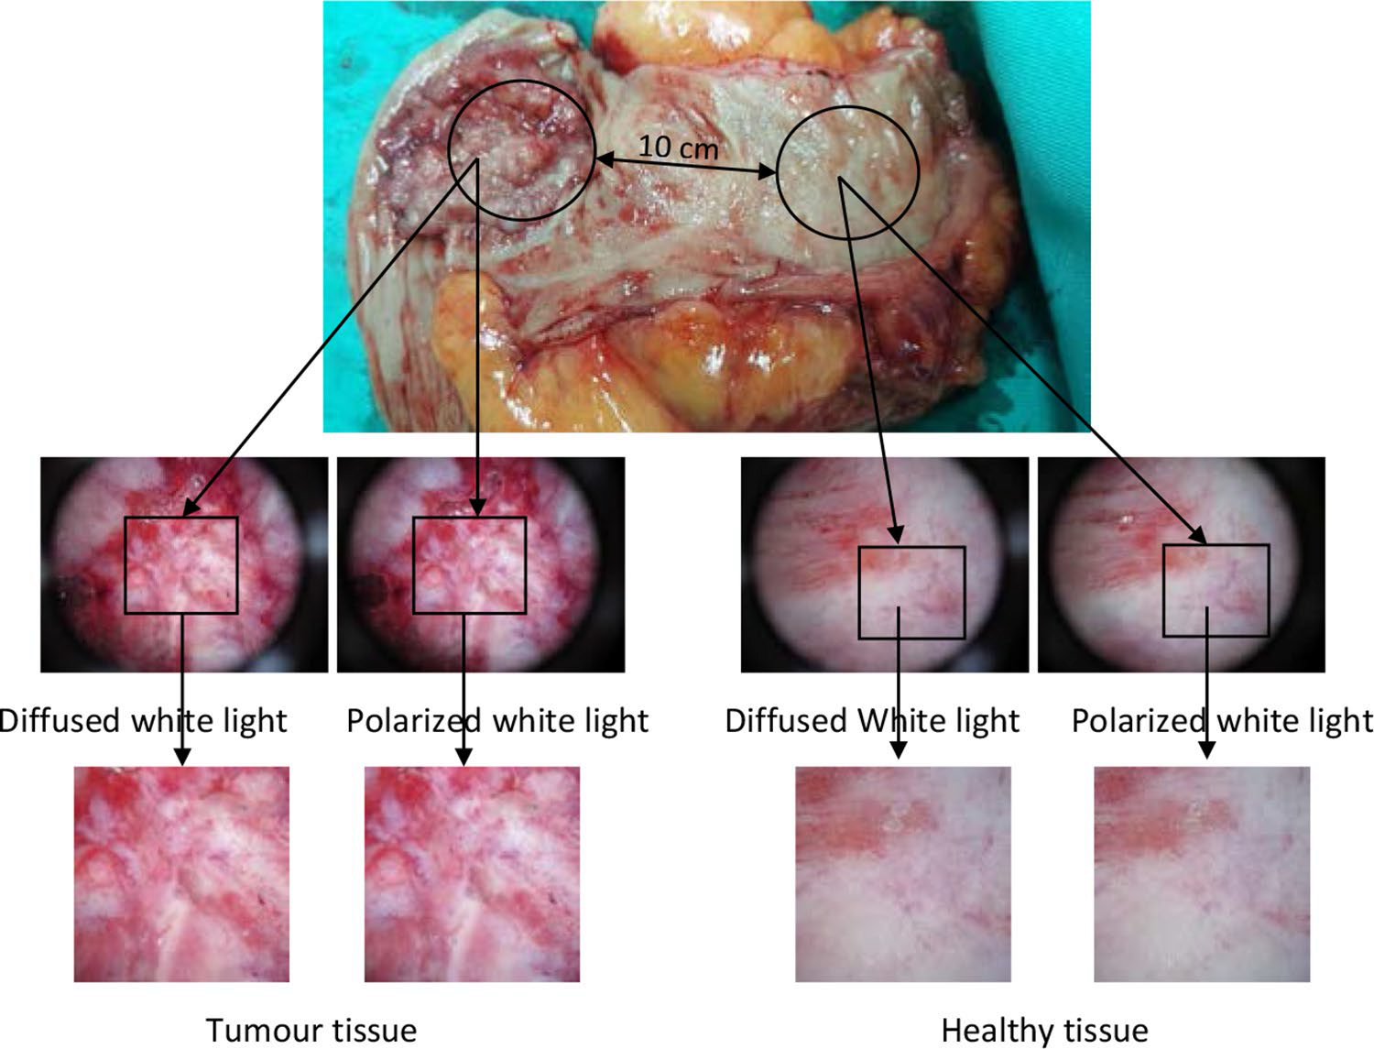
Opto-magnetic imaging spectroscopy
Sample of the colon tissue after surgical removal and marked places from which the images were taken

Slide 8
Opto-magnetic spectrum
OMIS spectrum = (spectrum of image formed by the diffused white light) - (spectrum of image formed by the polarized light)
Sample:
Here we have get the spectrum from the histogram of the pixels of image where brightness or the intensity is the differentiating parameter.
And as sample we have consider apple where we tried to differentiate rotten and fresh apple on the basis of OMIS spectrum.

Slide 9
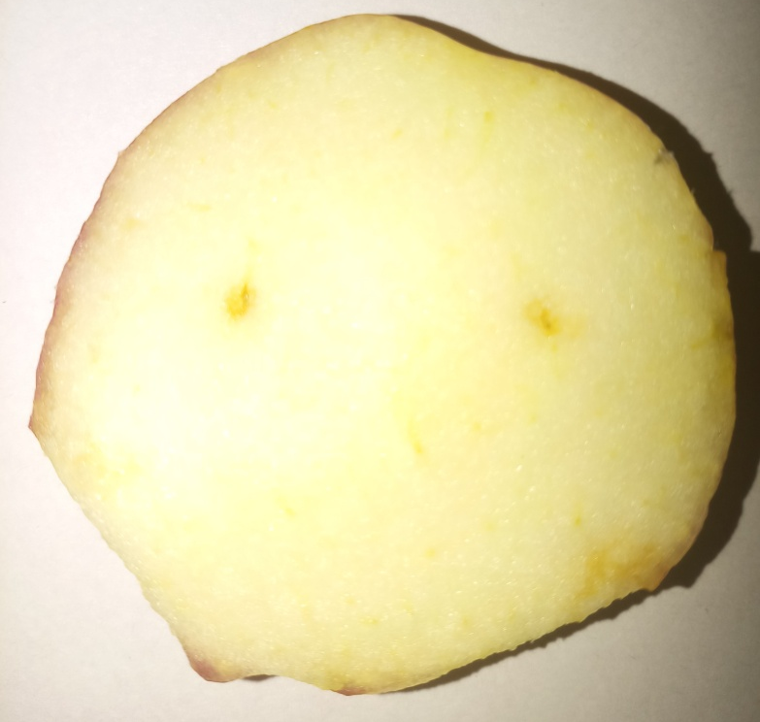
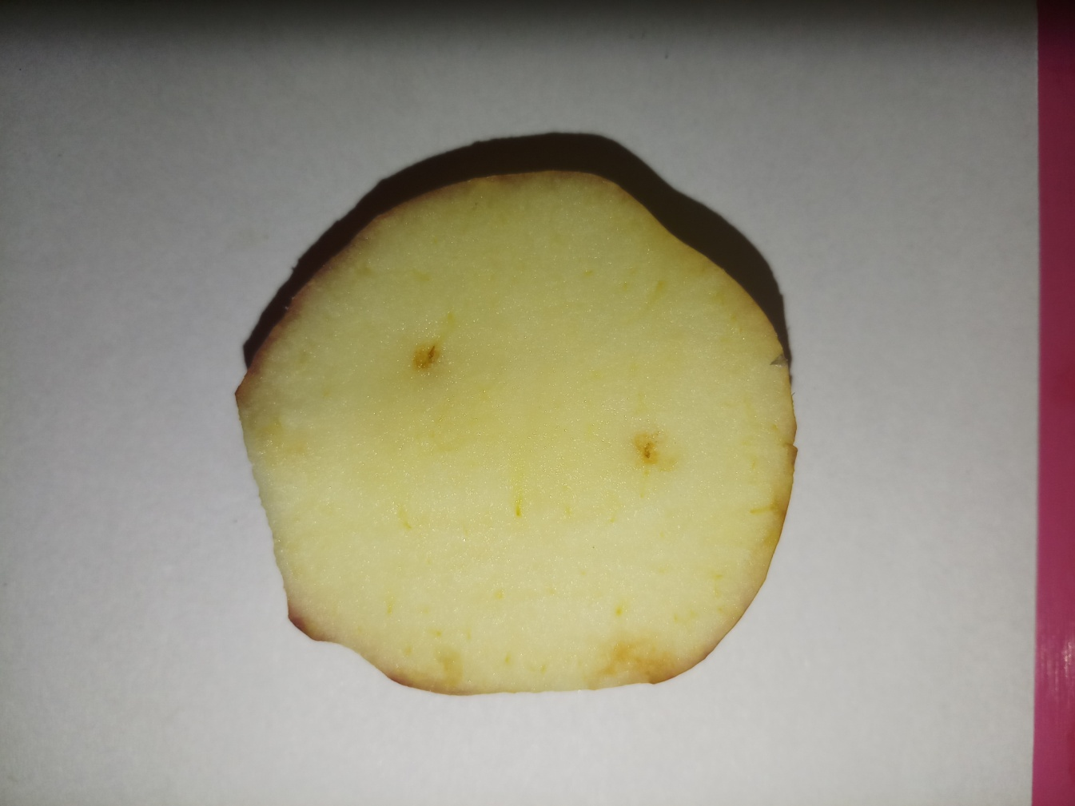
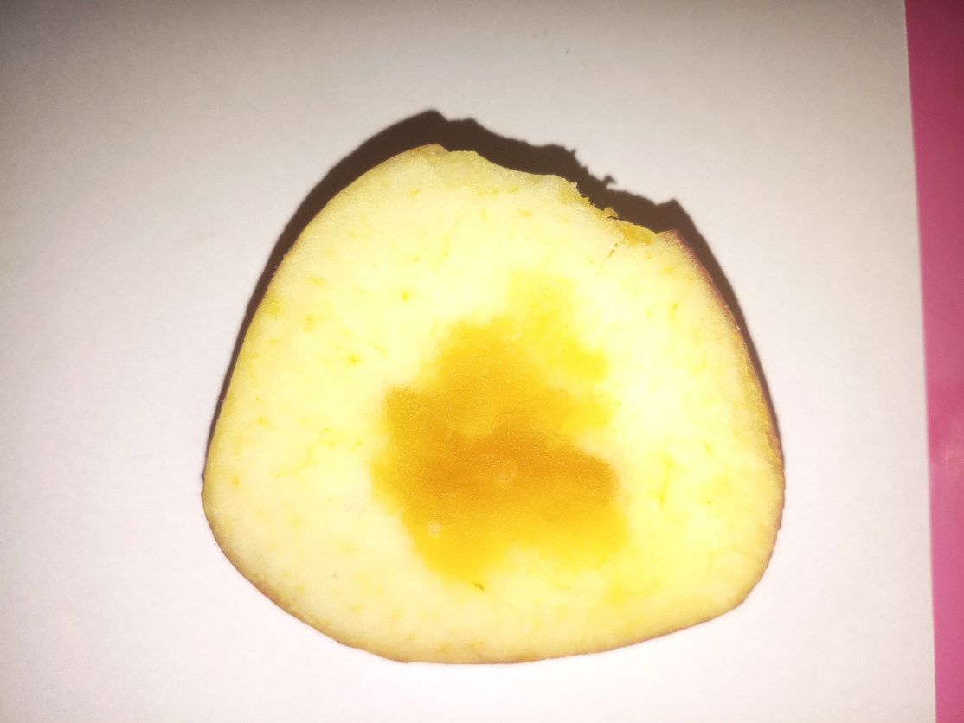
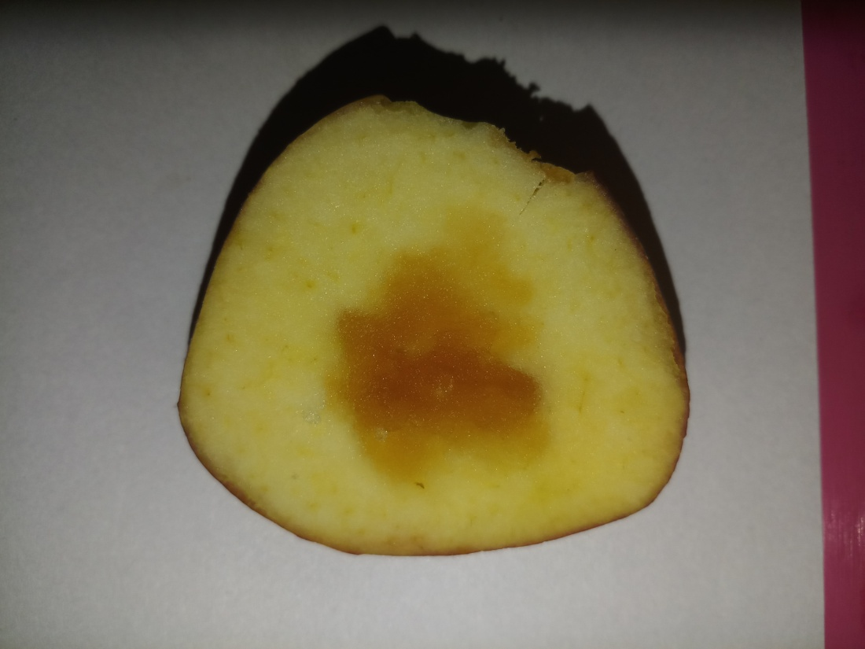
Classification of Fresh Apple and Rotten Apple
Fresh Apple
Rotten Apple
Light source perpendicular
to the sample
Light source at Brewster angle
(53 degree) to the sample

Slide 10
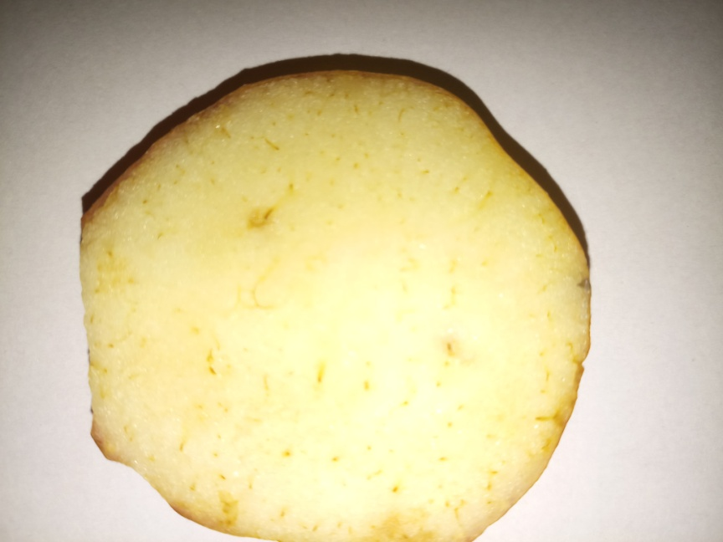
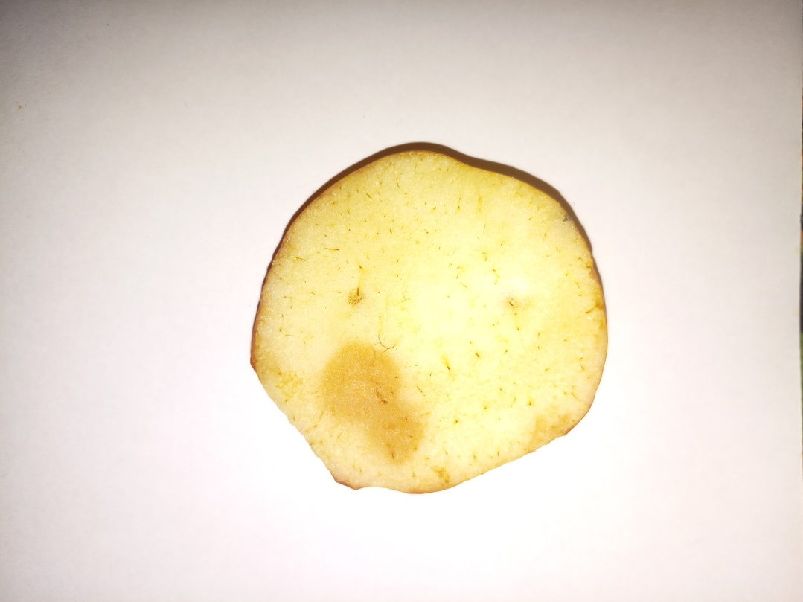
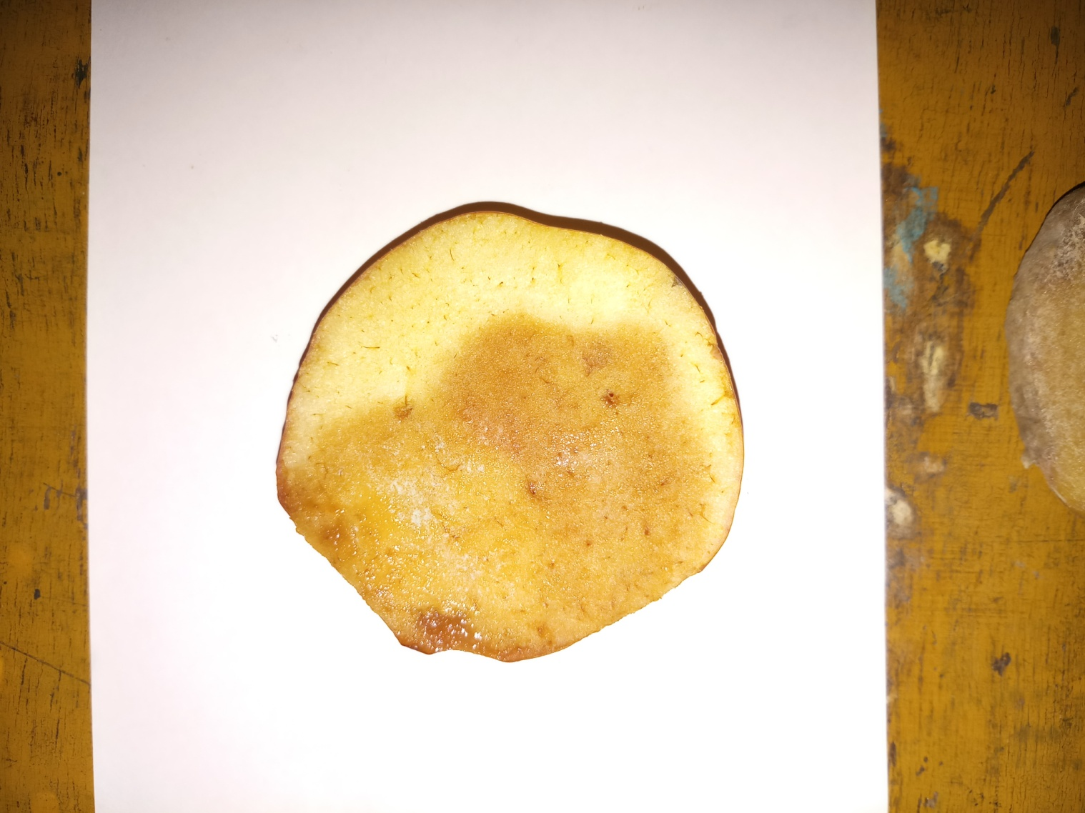
Classification of Fresh Apple and Rotten Apple
Day 1
Day 3
Day 5
Day 7

Slide 11
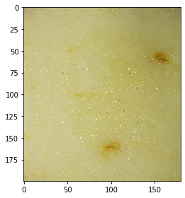
Image Processing
Whole sample was divided into smaller section and for each of
the section OMIS was produced.

Slide 12
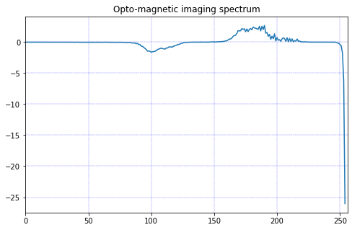
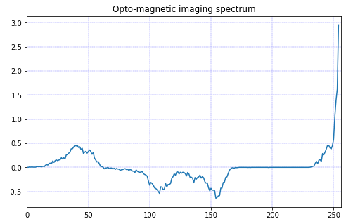
Steps of Image Processing
Smaller segments of both the images are formed.
Red, Green and Blue channels are extracted and normalized.
Each of the channels of polarized reflected light image are subtracted from that of white diffused light image.
Blue channels are subtracted from red channel in order to obtain the changes in the superficial and deeper layers.
Opto-magnetic spectrum of fresh apple
Opto-magnetic spectrum of rotten apple

Slide 13
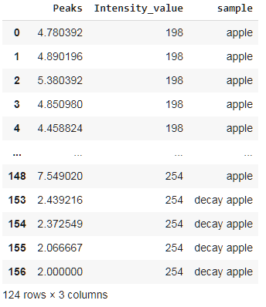
Various machine learning models for classification
Here all the peaks of spectrum are considered for classification
ML models | Accuracy
Logistic Regression | 0.8
KNN | 0.92
SVM | 0.84
Naïve Bayes | 0.6
Decision Tree | 0.96
Random Forest | 0.96

Slide 14
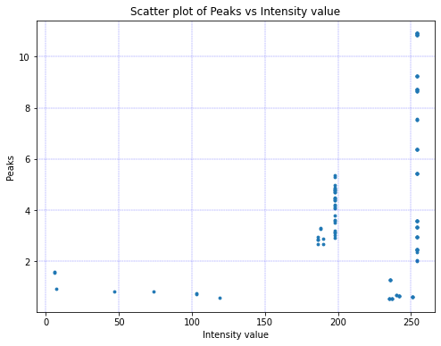

Slide 15
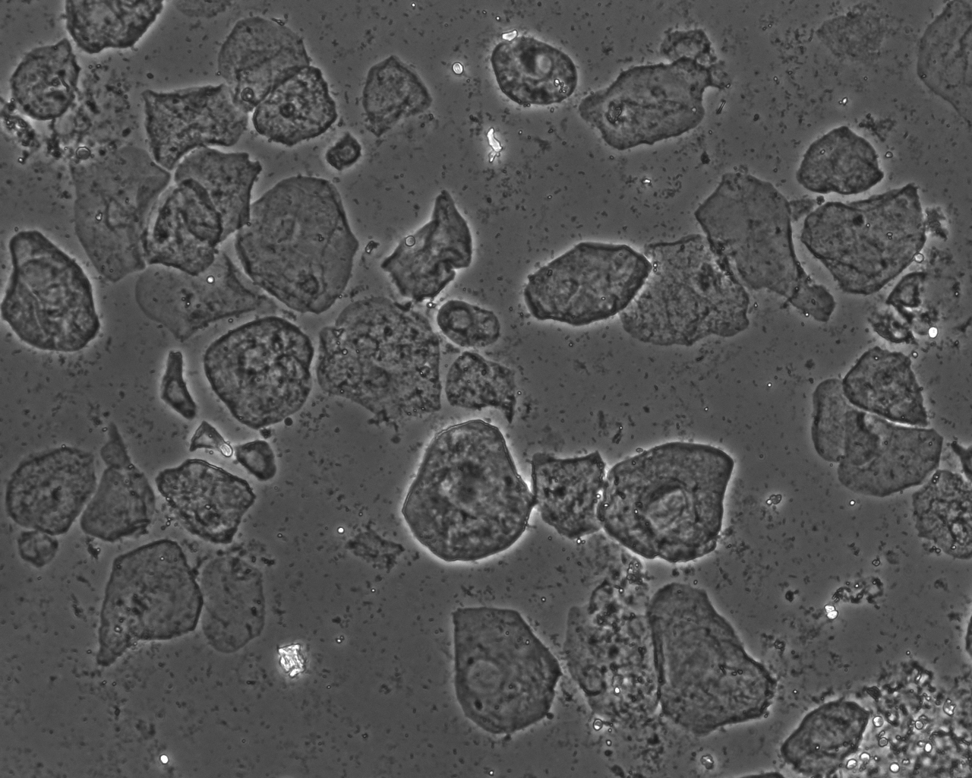
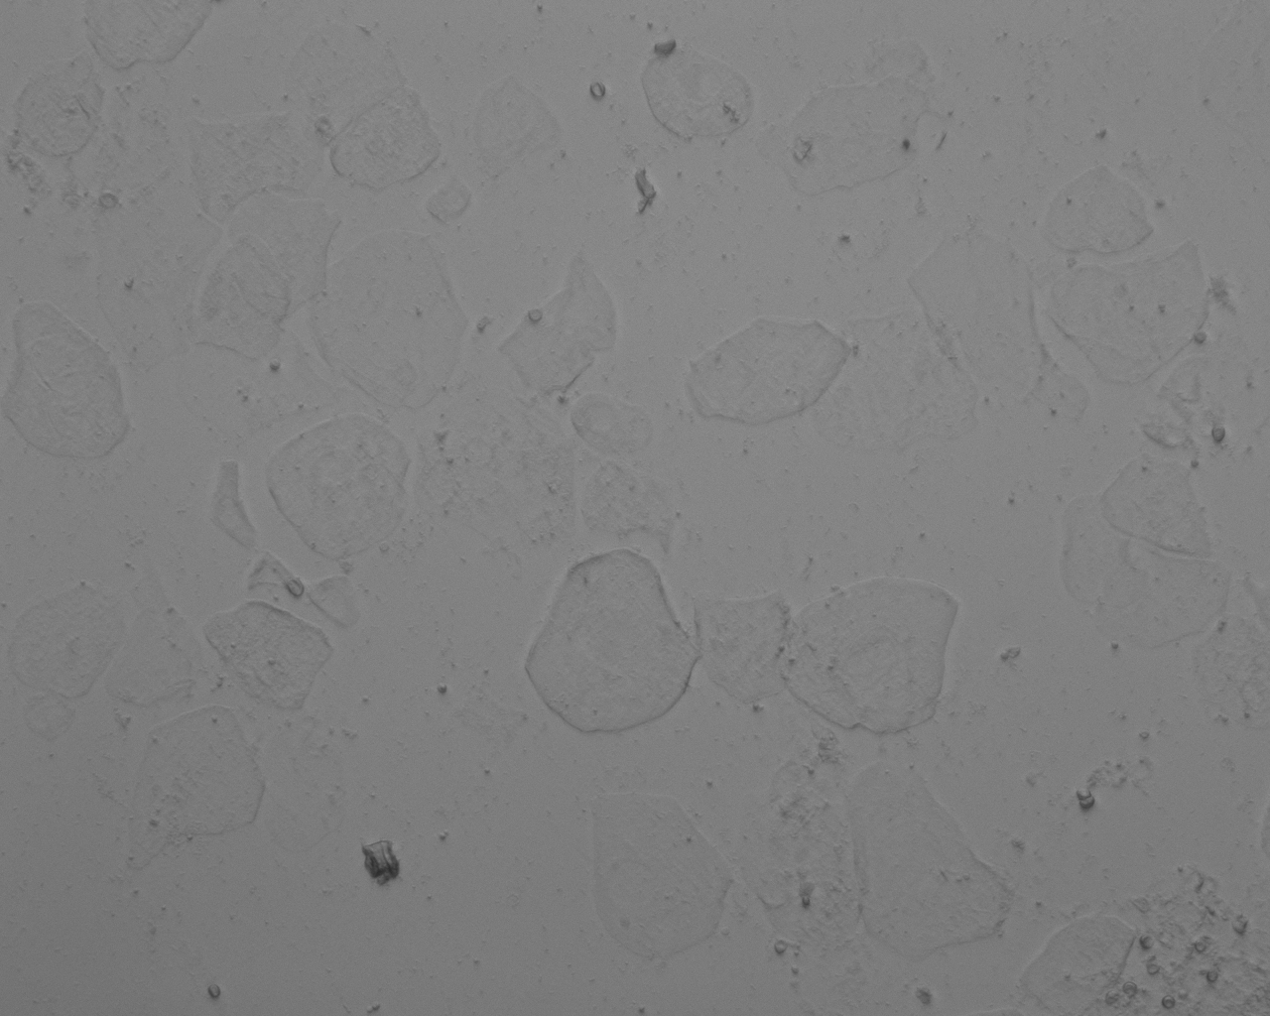
Limitations of this OMIS technique
There was no evidence whether the light was polarized by the sample or not.
Opportunities
Integrating both macroscopic and microscopic studies may yield
Robust model for isolating cancer cells from healthy cells.
Phase contrast image
DIC image

Slide 16
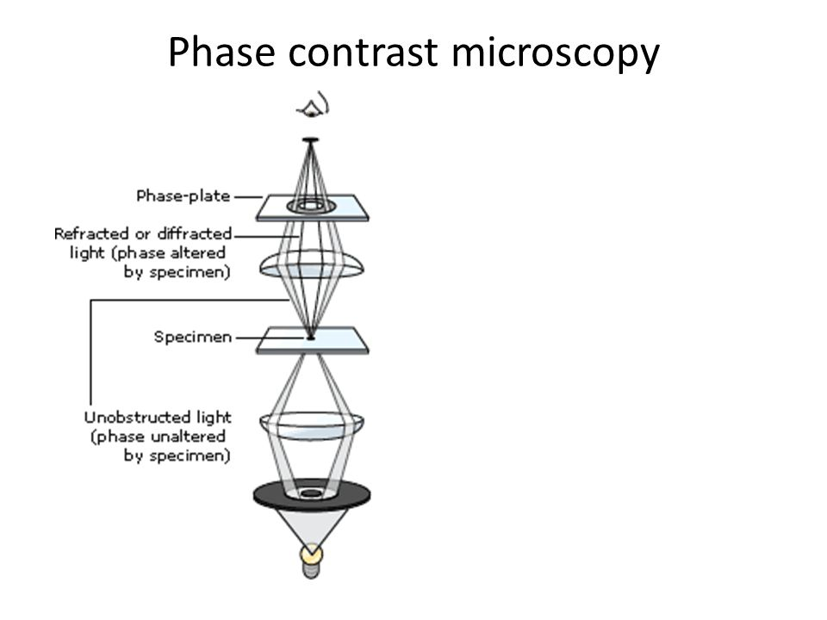
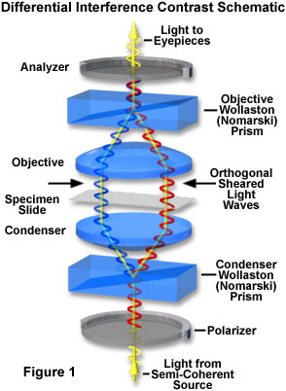
Opto-magnetic imaging spectroscopy
Schematic diagram of
Phase Contrast Microscopy
Schematic diagram of Differential
Interference Contrast Microscopy

Slide 17
Opto-magnetic imaging spectroscopy
Phase contrast image
DIC image

Slide 18
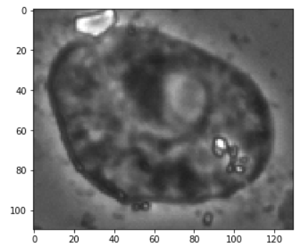
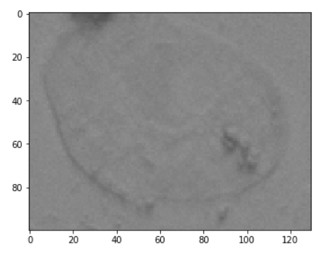
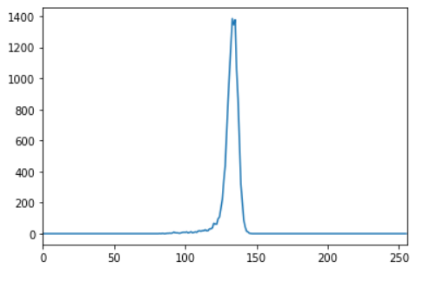
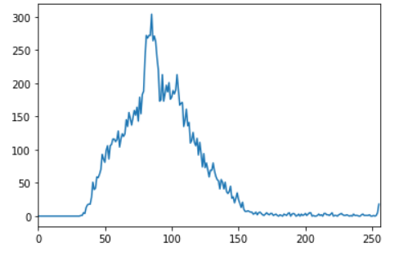
Microscopic image processing

Slide 19
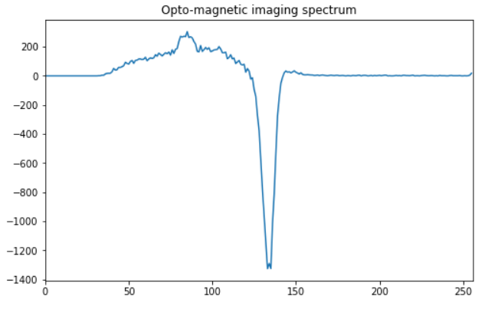
Opto-magnetic spectrum of microscopic image

Slide 20

Detection of breast cancer using transfer
learning technique on VGG19 model
VGG model was developed by Visual Geometry Group at Oxford university which is a successor of Alexnet.
Architecture of VGG 19 model

Slide 21
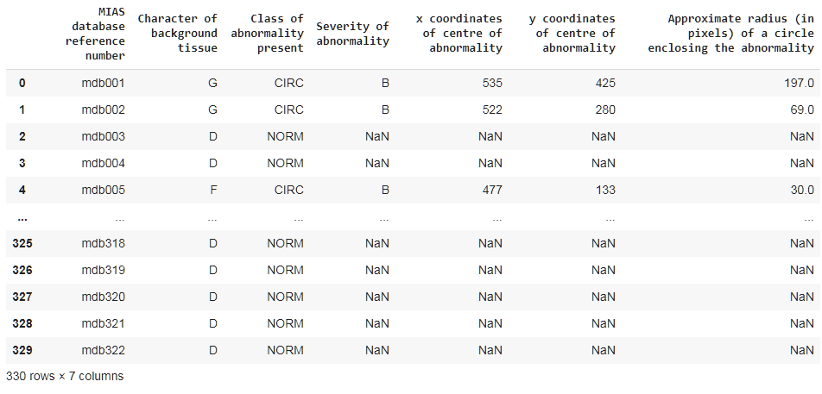
Level dataset of MAMMOGRAPHIC IMAGE
ANALYSIS SOCIETY (MIAS) database
With transfer learning technique and 123 images
the accuracy was 77 %.

Slide 22
Software and Libraries used:
Programming language: Python
IDE: Jupyter Notebook and Google Colab (GPU- Tesla T4)
Libraries:
Panda, Numpy (Data processing and analysis)
Matplotlib and OpenCV (Image processing and Plotting)
Scikit learn (Machine learning models)
Tensorflow (Transfer learning )

Slide 23
References:
Optomagnetic Imaging Spectroscopy Application in Cervical Dysplasia and Cancer Detection: Comparation of Stained and Unstained Papanicolaou Smears. DOI 10.1007/s40846-017-0255-z
2. Classification of Healthy and Cancer States of Colon Epithelial Tissues
Using Opto‑magnetic Imaging Spectroscopy.
DOI 10.1007/s40846-018-0414-x
3. Predictive Value of Opto‑magnetic Imaging Spectroscopy
in Discriminating Oral Squamous Cell Carcinoma from Non‑tumor
Tissue in Surgical Margins. DOI 10.1007/s40846-019-00473-y
4. Diagnosis of breast cancer based on modern mammography
using hybrid transfer learning. DOI 10.1007/s11045-020-00756-7
5. Breast cancer detection using deep convolutional neural networks and
support vector machines. DOI 10.7717/peerj.6201
6. Deep Learning to Improve Breast Cancer Detection on Screening Mammography
DOI 10.1038/s41598-019-48995-4

